Slide 1
COMP814 – Text Mining Word Embedding

Slide 2
So far…
Word to vector models is able to entail the importance of a word (TFIDF) and the frequency of particular words in documents.
Can we embed semantics into words so that we can express that king and queen are related and queen and woman are related?
Or, that queen and woman are more related than queen and tree.

Slide 3
Language Models
Count based methods
Compute the statistics of how often some word co-occurs with its neighbour in a large corpus.
BOW models, TF and TFIDF models.
Sparse vectors.
Predictive models
Directly try to predict a word from its neighbours from learned small, dense embedding vectors.
Word2vec is a computationally efficient predictive model for learning word embeddings from raw text.
Continuous BOW (CBOW) and Skip-gram are two predictive models.

Slide 4
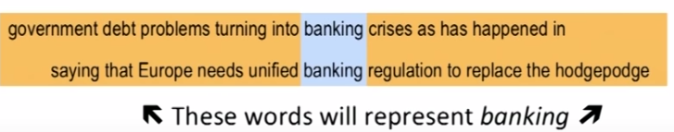
Two forms of meaning representation
Denotational: representation of meanings/concepts by symbols, art, set of alphabets
Distributional: meaning determined by other neighbouring words (context) in which a word appears.

Slide 5
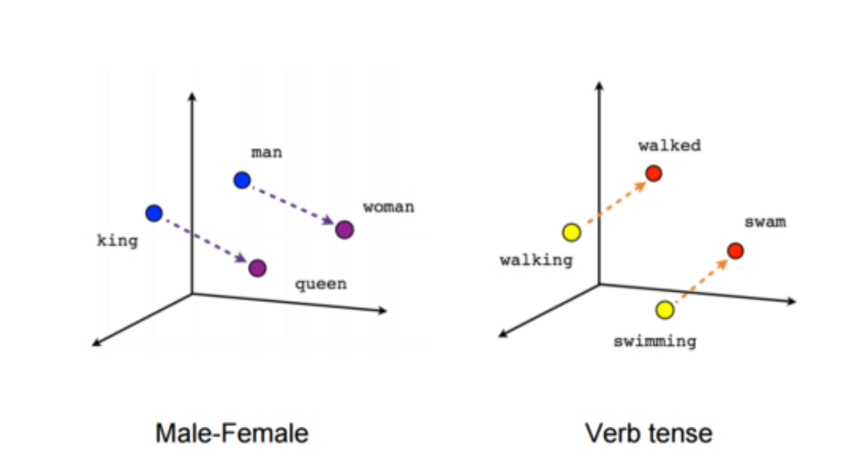
Word Embedding
Words are mapped into an n-dimensional space
Enables us to represent “semantics” between words.
Skipgram and CBOW models by Stanford

Slide 6
Word Embedding models
Predict the (context) neighbouring words given a focus word
Or predict the focus word given a context

Slide 7
Vector Representations
We want to be able to represent that “King” and “Queen” are related.
Word embeddings: where semantically similar words are mapped to nearby points.
Projections on an n-dimensional plane.
Based on distributional hypothesis: words that appear in the same context share semantic meaning.
Two models:
Continuous Bag or Words(CBOW) : predicts target word from context words
Skip-gram model: does the inverse, ie. Predicts context words from the target word.

Slide 8
Skip-gram model
“the quick brown fox jumped over the lazy dog”
Window - words to the left and to the right
Focus word: quick
Context words: the and brown for window size of 1.
Words: the and brown
Whole dataset: (quick, the), (quick, brown), (brown, quick), (brown, fox), ….
The problem decomposes to prediction of (input,output) pairs.
For a large enough corpus this will capture context of the target word.
Models semantically or otherwise related words. Ie. Context for a word.

Slide 9
Skip-Gram model
Train a NN to on data and use the weights vector as the look up.
Same principle applies for CBOW but in inverse.

Slide 10
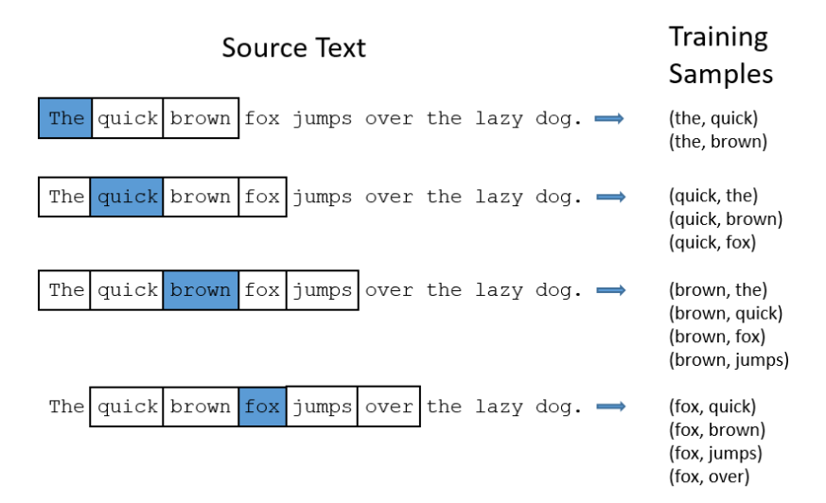
An example for window size 2

Slide 11
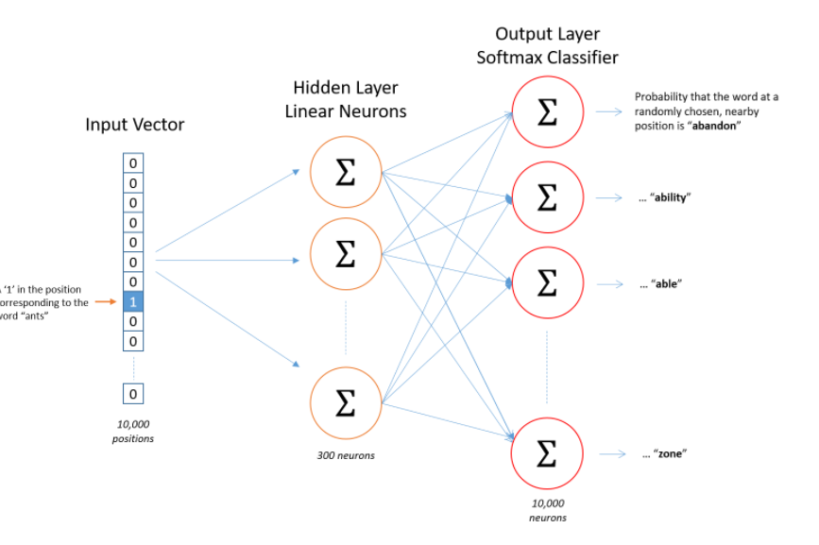

Slide 12
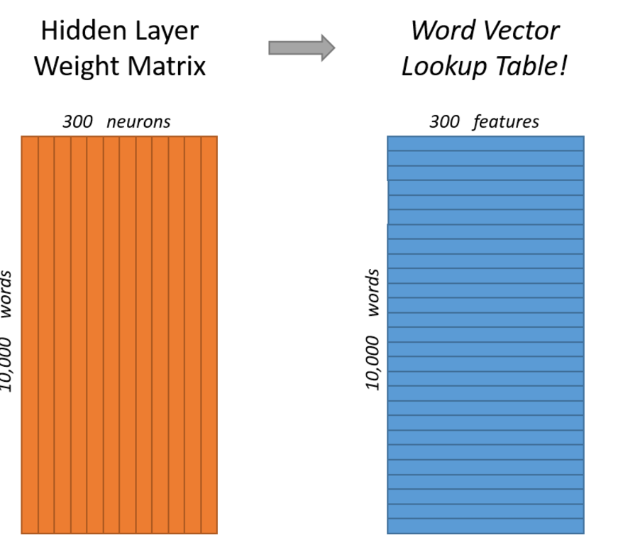
The matrix functions as lookup table

Slide 13
Word Embedding using NN
Unsupervised learning
Algorithm uses NN for word vector representation
Does not use NN in a conventional sense
Uses the weights as the embedding matrix.

Slide 14
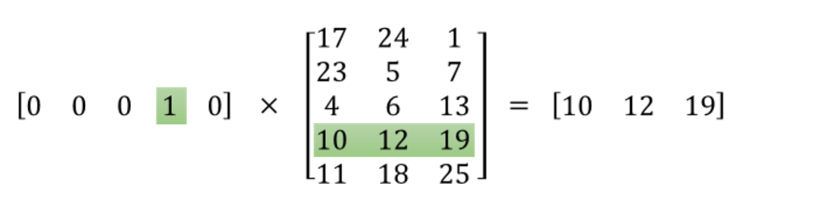
Matrix as a lookup table

Slide 15
GloVe: Global Vectors for Word Representation
Developed by Stanford as open source project.
Trained on Wikipeidia
Global Vectors for Word Representation (GloVe) is provided by Stanford NLP team. Stanford provides various models from 25, 50 , 100, 200 to 300 dimensions based on 2, 6, 42, 840 billion tokens.

Slide 16
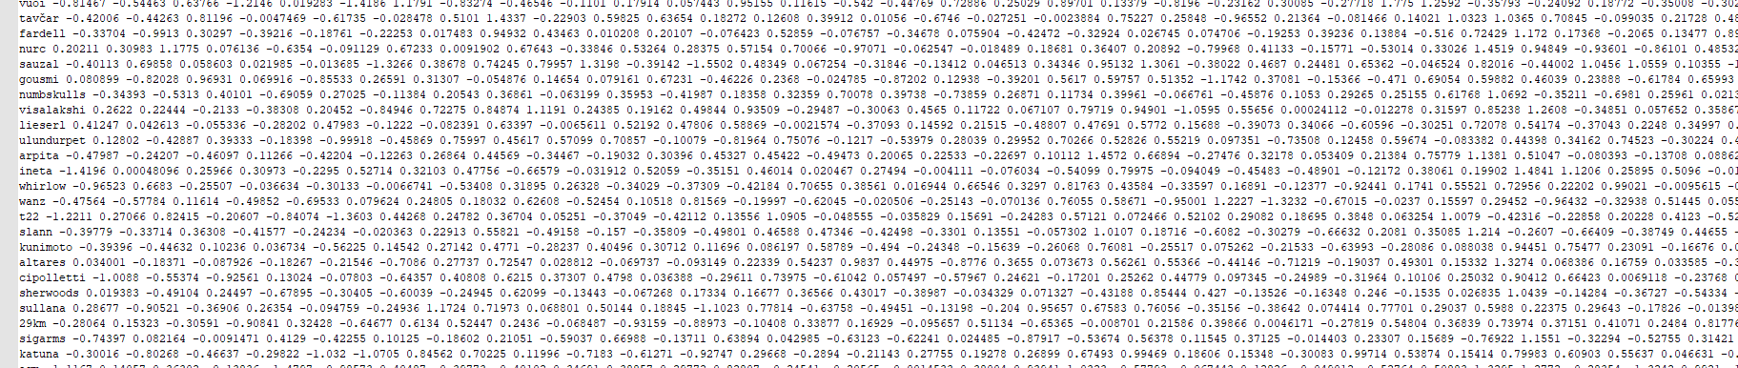
Snapshot of Glove
Glove.6B.50d.txt

Slide 17
Word2Vec/Skipgram explained further – youtube video
https://www.youtube.com/watch?v=UqRCEmrv1gQ

Slide 18
Skipgram code demo

